Slide 1
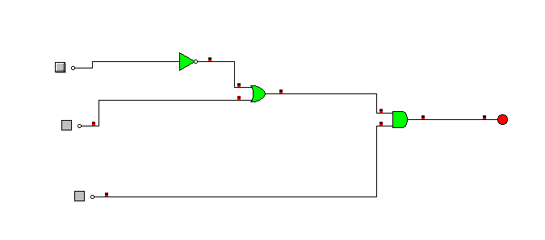
PUERTAS LÓGICAS
Salida= (â+b)*c
A | B | C | salida
0 | 0 | 0 | 0
0 | 0 | 1 | 1
0 | 1 | 0 | 0
0 | 1 | 1 | 1
1 | 0 | 0 | 0
1 | 0 | 1 | 0
1 | 1 | 0 | 0
1 | 1 | 1 | 1

